Slide 1


F1 Grand Prix Race Win Predictor
Apologies this will slightly go over the 5 minutes
And there are gifs/animations…
Sorry, I’m not sorry - I did check with Miranda ☺

Slide 2
Let me take you back to 2021…

Slide 3
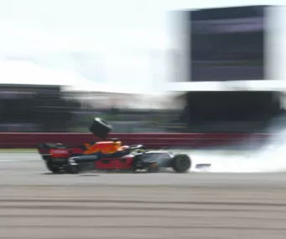
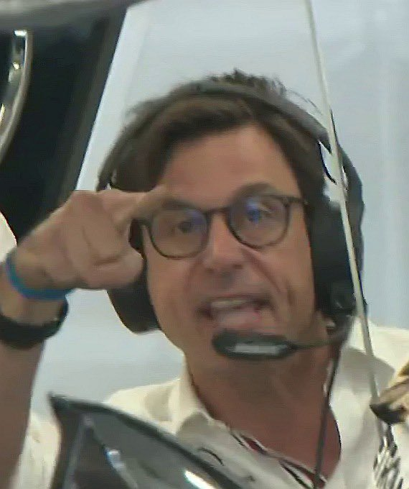
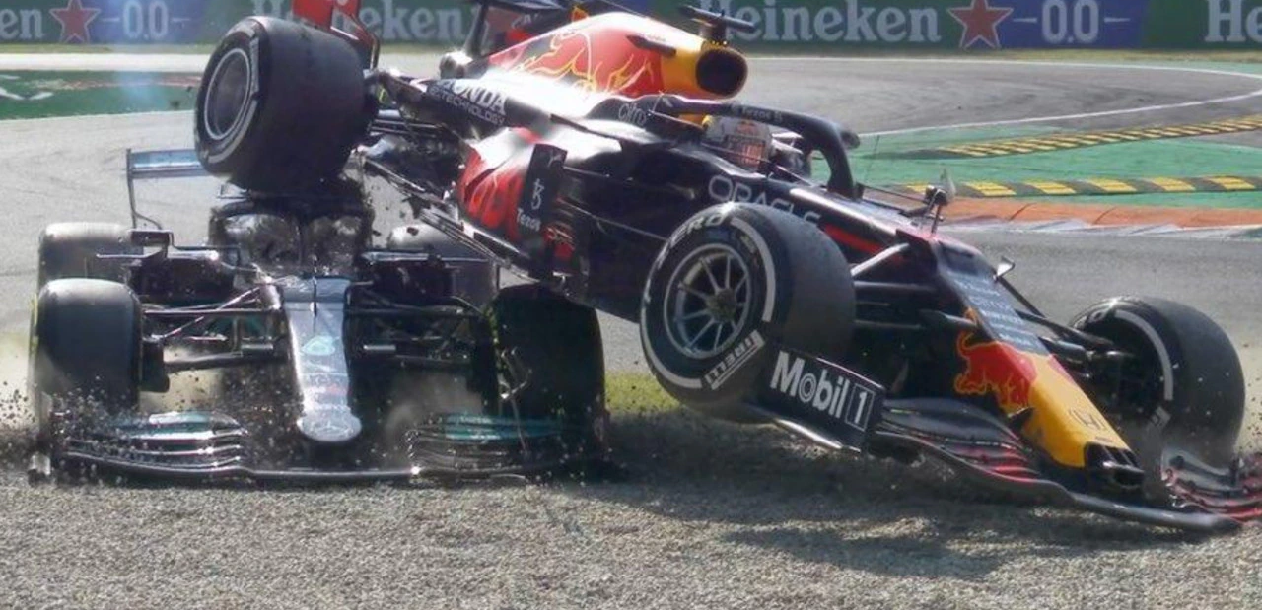
F1 2021 Championship
Lewis Hamilton (Mercedes) vs Max Verstappen (Red Bull)
Ferocious rivalry w/ incidents marking the season
Closest championship in F1 history

Slide 4
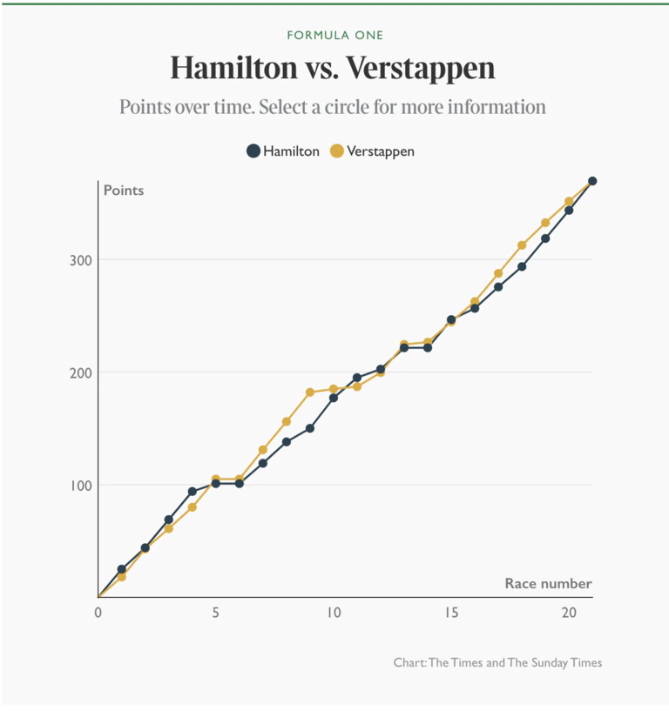

After 21 races, Lewis Hamilton and Max Verstappen tied in points (369.5 points each)
As data scientists we love a data visualisation
With one race to go….
Last Race – Winner Takes It All…

Slide 5
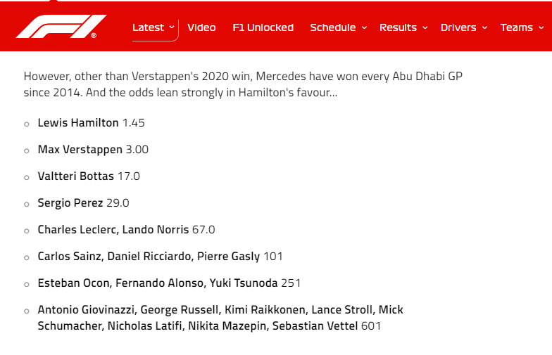
The odds were in Lewis Hamilton’s favour to win the last race…

Slide 6
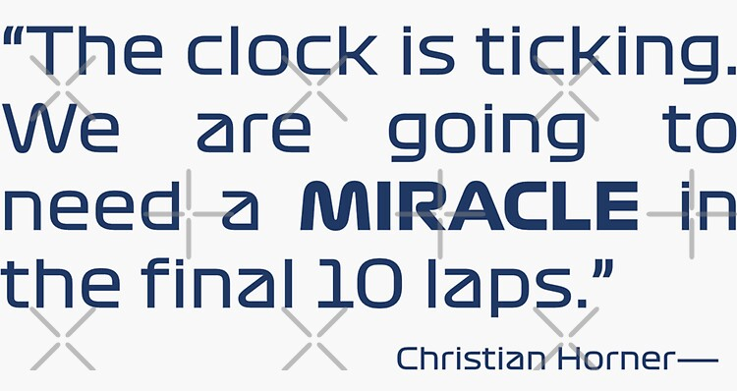
Qualification Battle: Verstappen secures pole position, Lewis gets second position.
Dramatic Overtake: Hamilton takes the lead early in the race.
Lewis grows his Lead: He is 11 seconds ahead with 5 laps remaining.
Lewis Hamilton looks like he is on his way to winning the race and his 8th World Championship…

Slide 7
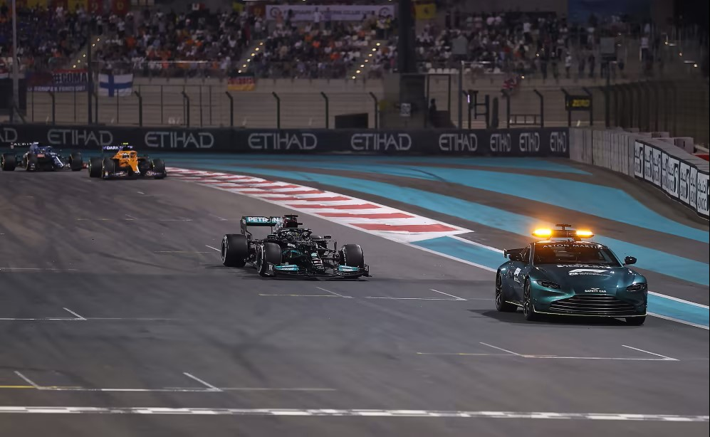
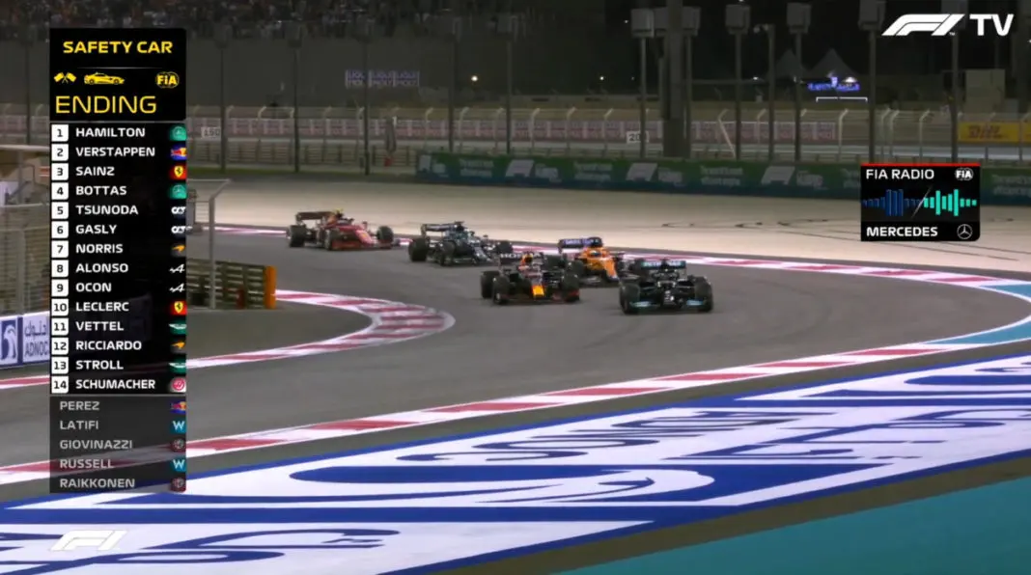
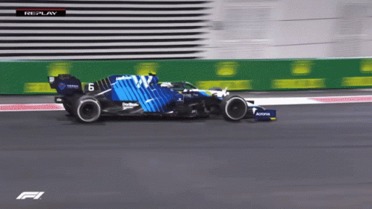
5 laps to go…unexpected twist (noise in the model)…

Slide 8
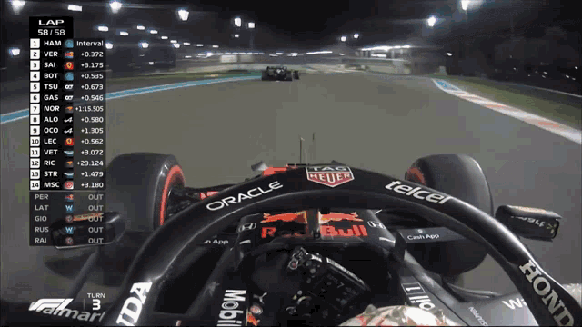
Last lap…another unexpected twist…

Slide 9
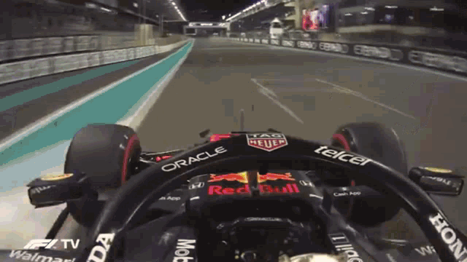
Max is the world champion…

Slide 10
Could we have predicted this outcome?

Slide 11

Vision for Tackling the Problem with Data Science
We will find out….
Classification Challenge: Predicting the F1 race winner is a classification problem in data science
Machine Learning Models: Start with Log Regression & use machine learning models to help with predicting race winners (e.g. Neural Network Classifiers, Random Forest Classifiers)
Feature Engineering: Identify and engineer key variables for accuracy.
Model Optimization: Continuously refine models based on new data and feedback.

Slide 12
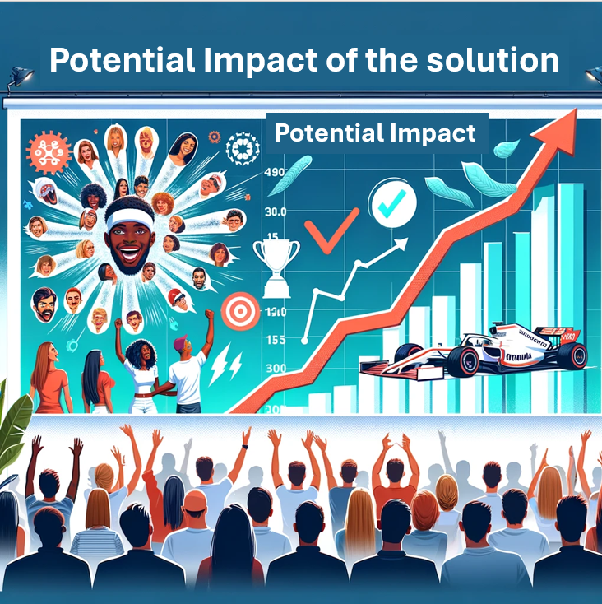

Potential Impact of the Solution
In reality this will probably just be a fun project for my BrainStation course, and may help me with my interest in Data Science and F1…
Strategic Advantages: Enhances team decision-making for race strategies, driver selection, etc.
Fan Engagement: Deepens fan involvement with predictive insights.
Performance Insights: Offers teams data-driven performance enhancements.
Market Influence: Potential to shift the $235 billion sports betting industry.

Slide 13
Introduction to the Dataset & EDA Findings
Dataset Overview: Comprehensive F1 race data (on a driver level for each race) from 1995-2023.
Volume and Variety: Includes 11.2k rows and 37 columns (e.g. race winner, starting grid position, engine manufacturer, fastest lap time, etc.)
Data Quality Concerns: Identified missing values in 7 columns and inconsistencies (e.g. the races weren’t in order).
Preliminary EDA Insights:
Dominance of certain teams (Mercedes & Red Bull) and drivers (Lewis Hamilton and Michael Schumacher) in historical data.
The data is imbalanced (95.39% non-wins, 4.69% wins) which can challenge prediction models to avoid bias towards the majority class.

Slide 14
Next Steps: Data Processing, Feature Engineering, & Modeling
Data Cleaning: Refine dataset by handling missing values and duplicates
Feature Selection: Identify predictive variables for race outcomes.
Feature Engineering: Create new features from existing data for insights.
Normalization: Scale data to prepare for modeling.
Baseline Model: Start with logistic regression for classification.
Notes:
Feature selection – e.g. engine manufacturer, if the driver was a former F1 champion, what team they drive for, starting grid position, driver nationality, etc
Feature Engineering – points from the last race, cumulative points of the season, how quickly the team developed the car last year

Slide 15

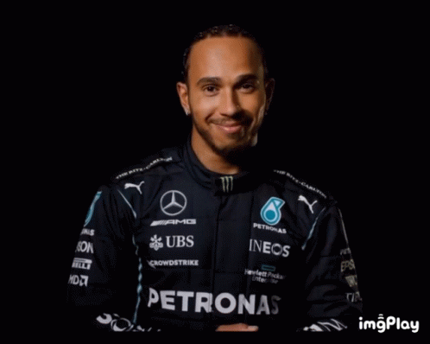
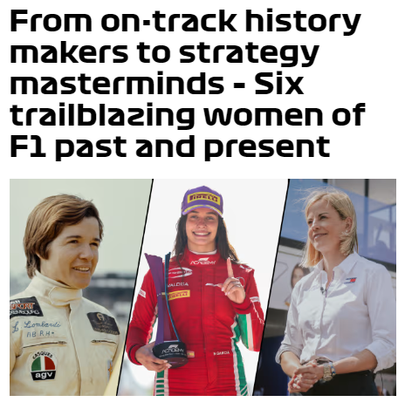
Thanks for your time & Happy Women’s Day

